Slide 1



VOIS Innovation
Marathon 2.0

Slide 2
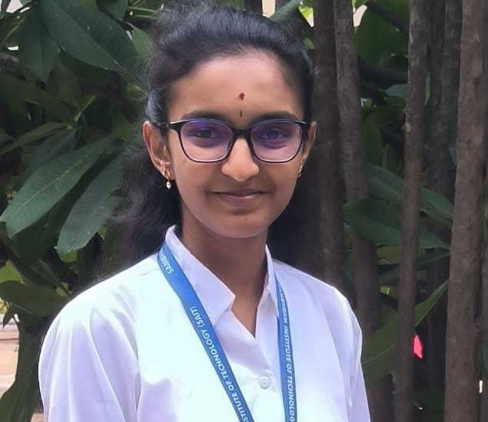

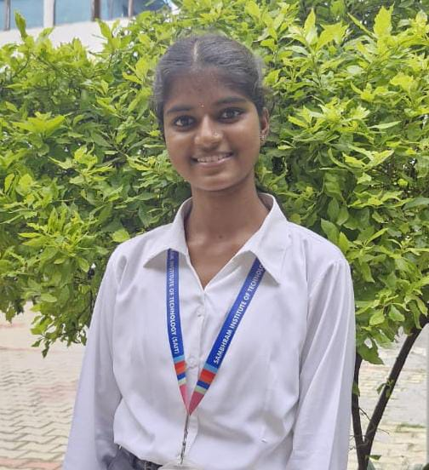
Unified Cybersecurity Simulation and Threat Intelligence Platform
Team Lead, Archana S R,
CSE (Cyber Security)
Team No. 38
Insert your professional photo
Sambhram Institute of Technology, Bengaluru, Karnataka
Ashwini B,
CSE (Cyber Security)

Slide 3





Problem Statement
Unified Cybersecurity Simulation and Threat Intelligence Platform
The Challenge: Government and enterprise employees in roles such as Administrative Officers, Finance Officers, and System Administrators are prime targets of phishing and social engineering attacks.
Attackers impersonate official communications such as tenders, invoices, salary notices, and internal approvals
In India, AIIMS Delhi suffered a major cyberattack in 2022 due to compromised employee access, disrupting critical healthcare services
In USA, MGM Resorts lost over $100 million in 2023 due to a cyberattack caused by social engineering targeting an employee
Even a single compromised account can lead to data breaches, financial loss, and operational disruption
Without behavior-driven cybersecurity awareness, administrative and finance personnel remain vulnerable to phishing attacks, leading to data breaches, financial loss, and operational disruption.
Source: CERT-In (India), AIIMS Delhi Reports, MGM Resorts Cyber Incident Report (2023)

Slide 4
Need of Project
Traditional cybersecurity training is static, theoretical, and does not simulate real attack scenarios
Government and enterprise employees require practical, behavior-based training to recognize phishing threats
Organizations lack measurable indicators to assess employee cybersecurity awareness and risk levels
There is a need for real-time threat intelligence and domain analysis to understand evolving cyber threats
A scalable, interactive platform is required to improve awareness, reduce human risk, and strengthen organizational security

Slide 5
Proposed Solution
Developed a Unified Cybersecurity Simulation and Threat Intelligence Platform
Provides realistic phishing simulations to train users in identifying cyber threats
Delivers guided security analysis with AI-driven explanations to improve awareness
Integrates real-time threat intelligence and SWHI module for malicious domain investigation
Generates Cyber Health Scores and dashboards to measure awareness and risk level
Generates Cyber Health Scores, dashboards, and engagement mechanisms to measure awareness, human risk, and encourage continuous participation

Slide 6
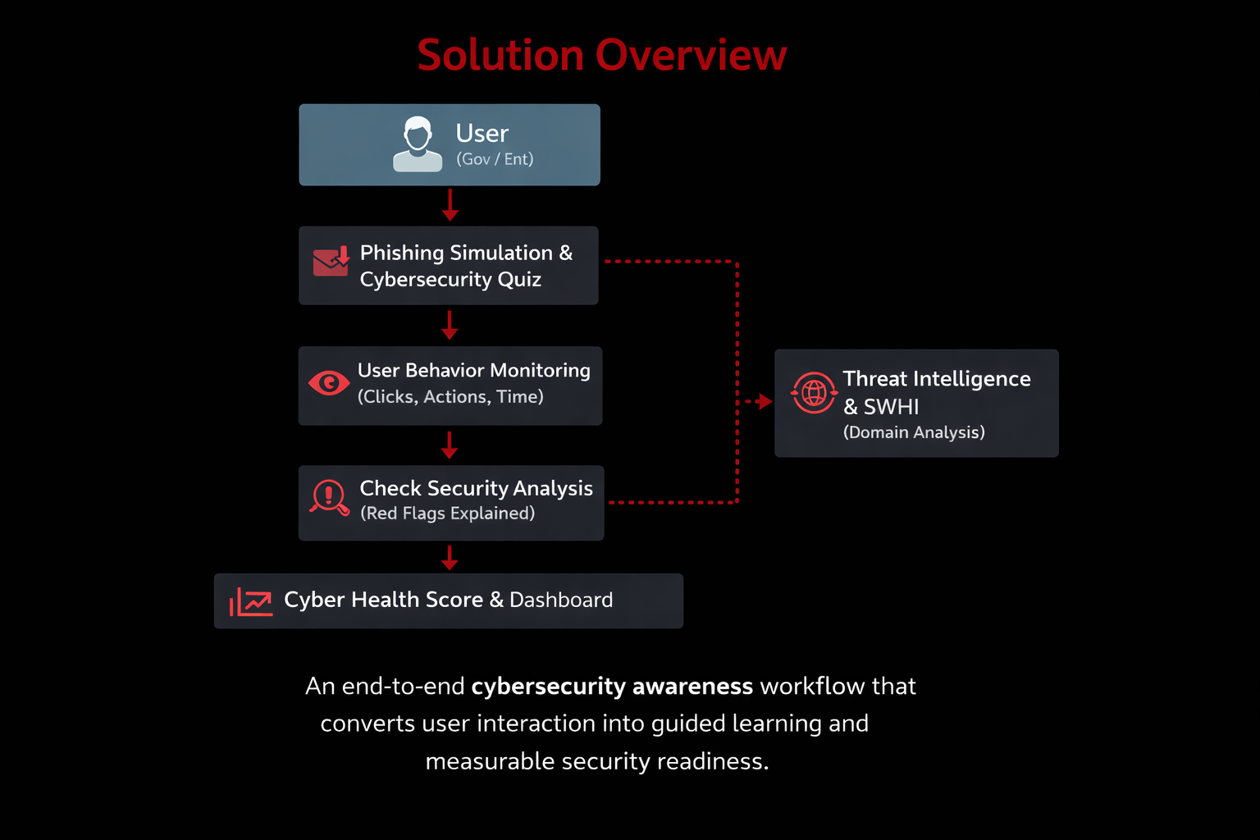
Solution Overview
End-to-End Cybersecurity Awareness Workflow
Users interact with realistic phishing simulations and quizzes
User behavior is continuously monitored
Check Security Analysis explains phishing red flags in real time
AI Awareness Coach provides guided security tips
Cyber Health Score & Dashboard measure awareness and risk
Threat Intelligence & SWHI extend learning with real-world context

Slide 7
Technology used
Frontend: React.js, HTML, CSS, JavaScript
Backend: Python Flask
Database: SQLite
Threat Intelligence: VirusTotal, Shodan, SecurityTrails APIs
Security & Integration: JWT Authentication, REST APIs, SWHI Module

Slide 8
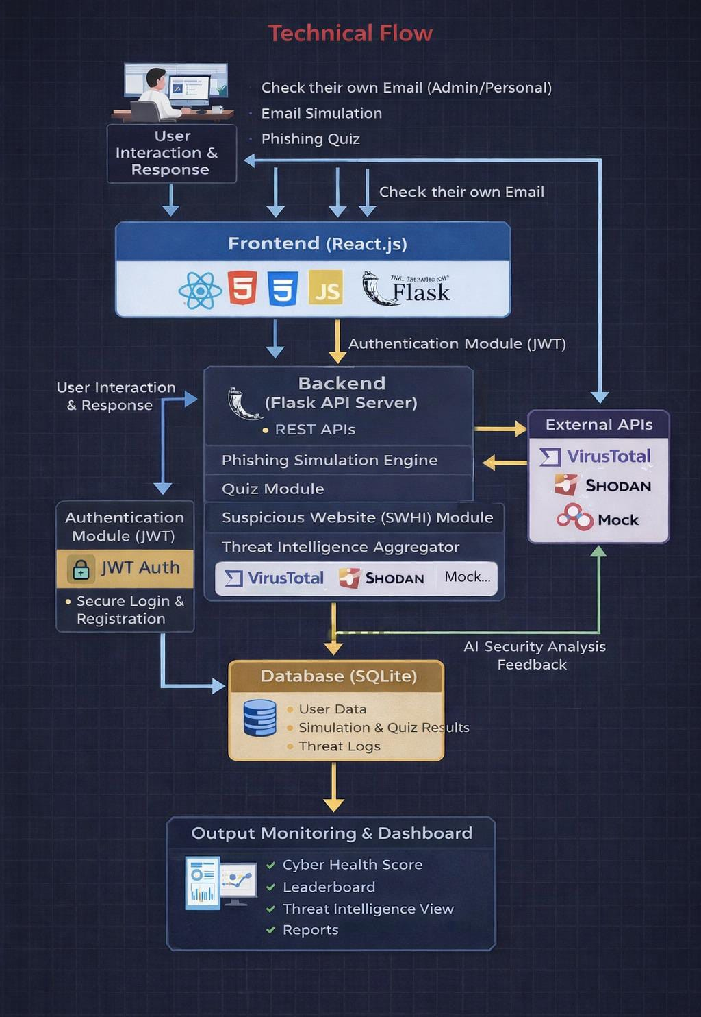
Technical flow diagram

Slide 9
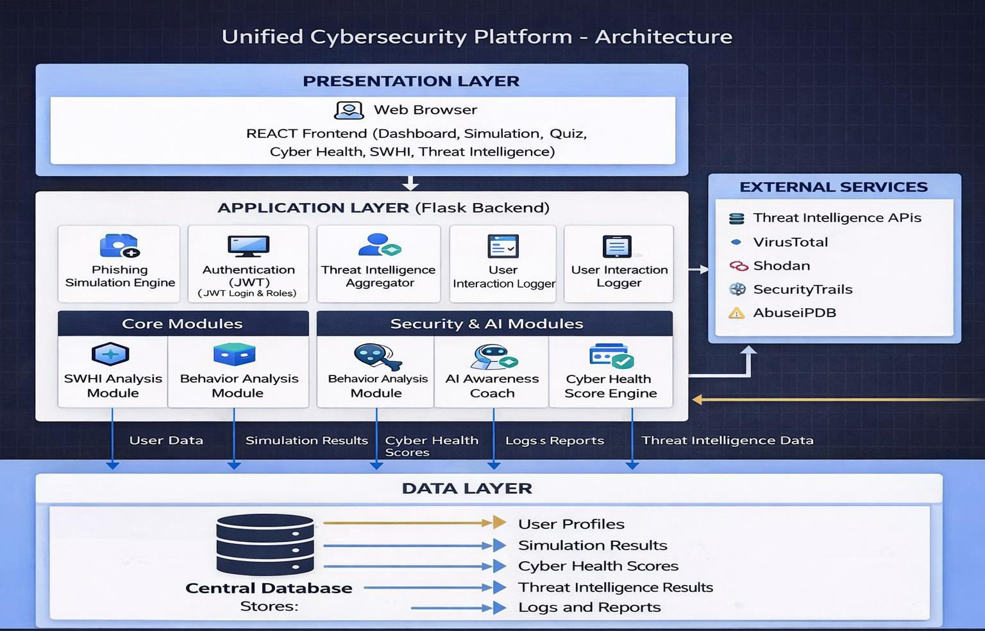
Architecture Blueprint

Slide 10
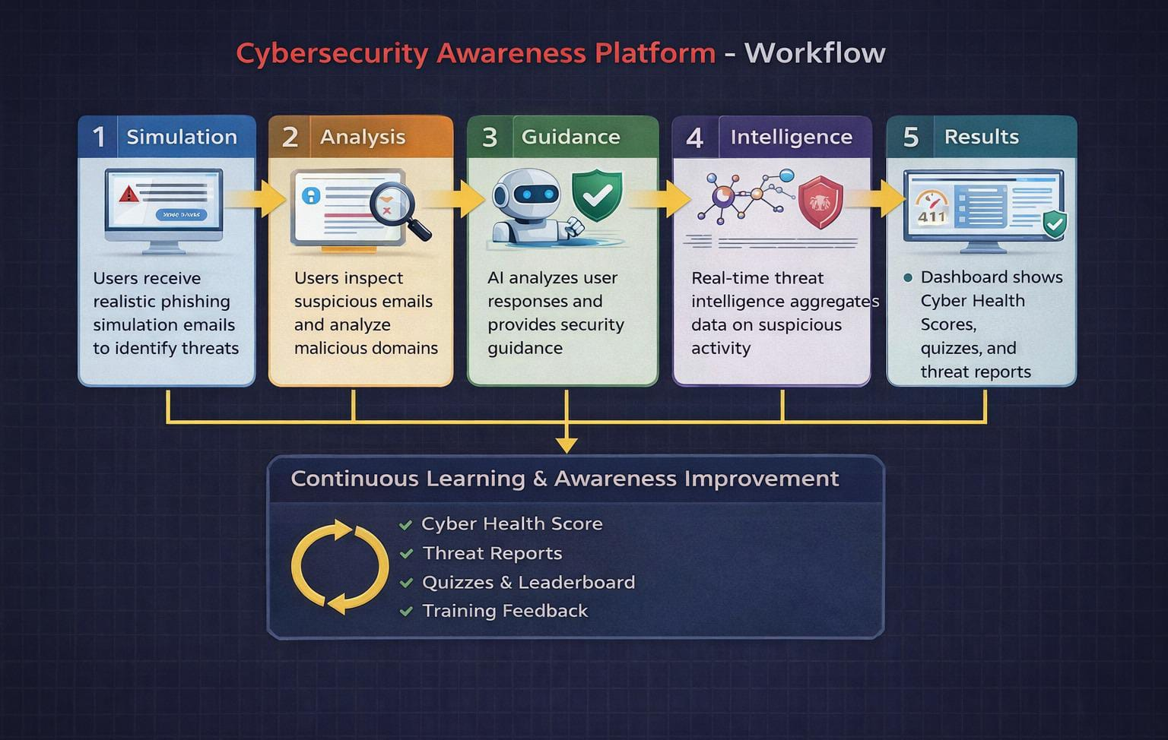
Workflow diagram

Slide 11
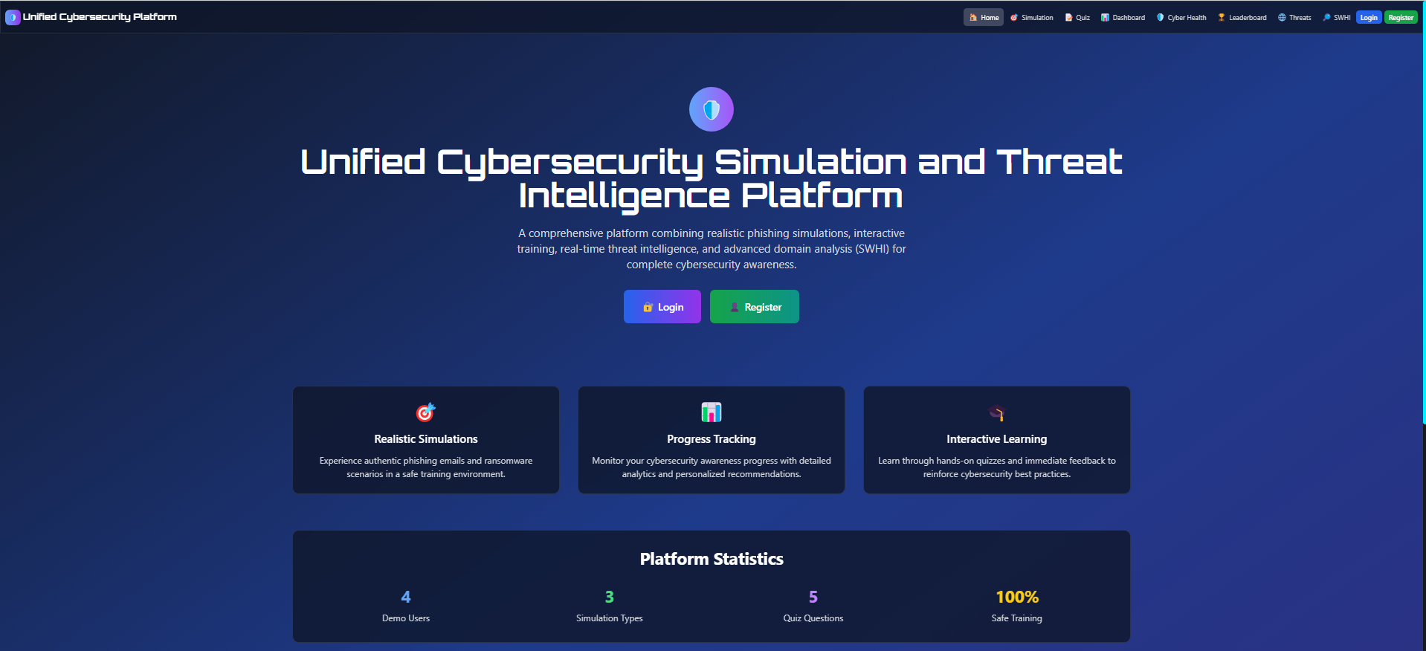
Screenshots

Slide 12
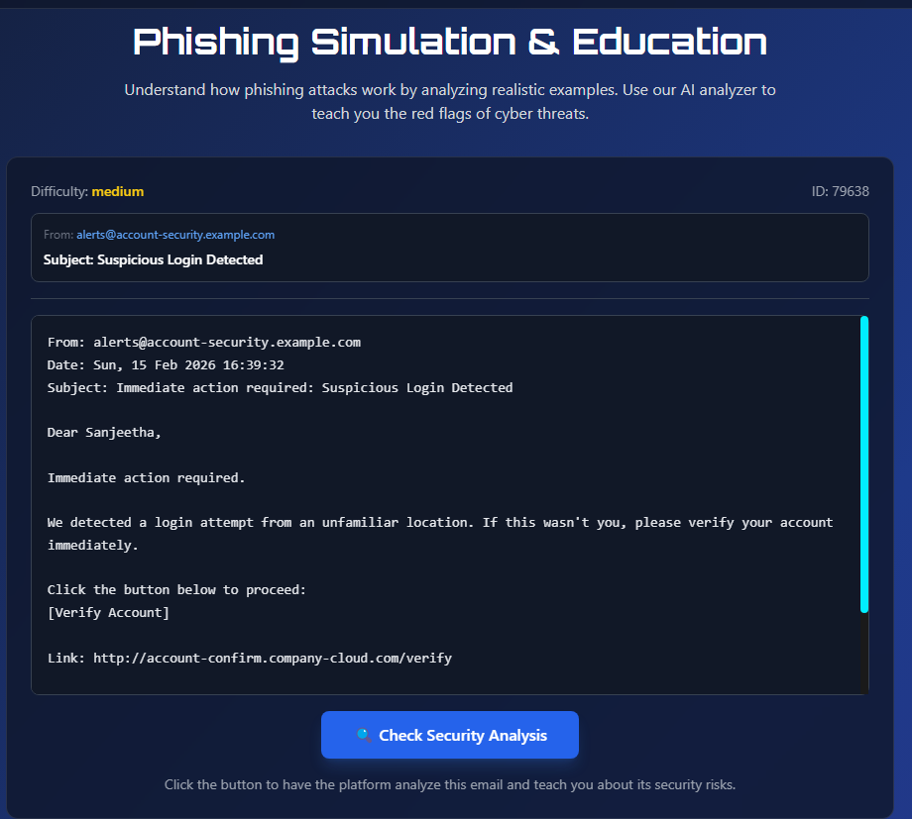
Screenshots

Slide 13
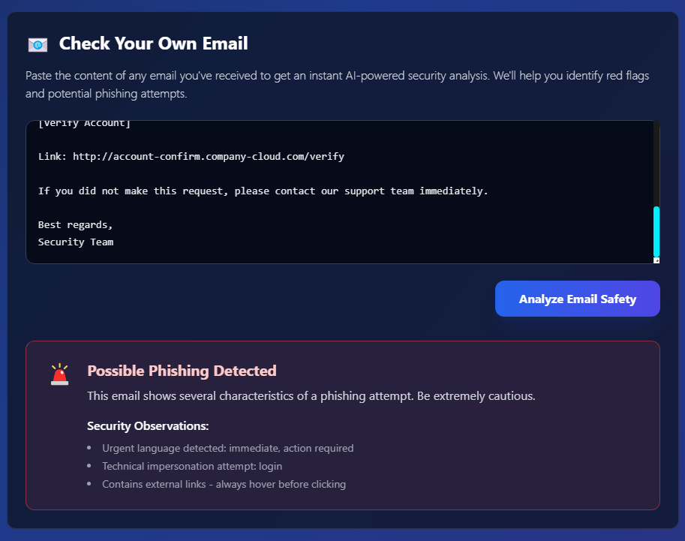
Screenshots

Slide 14
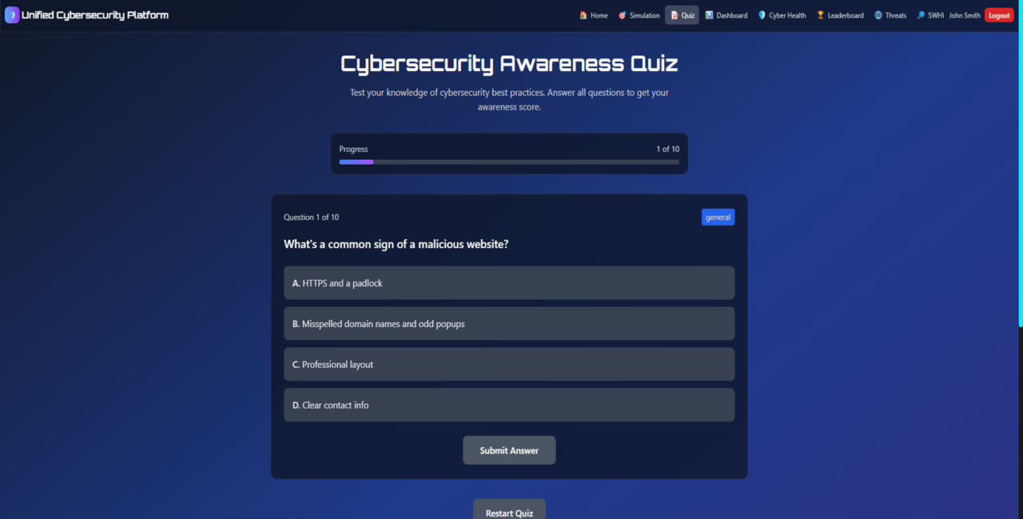
Screenshots

Slide 15
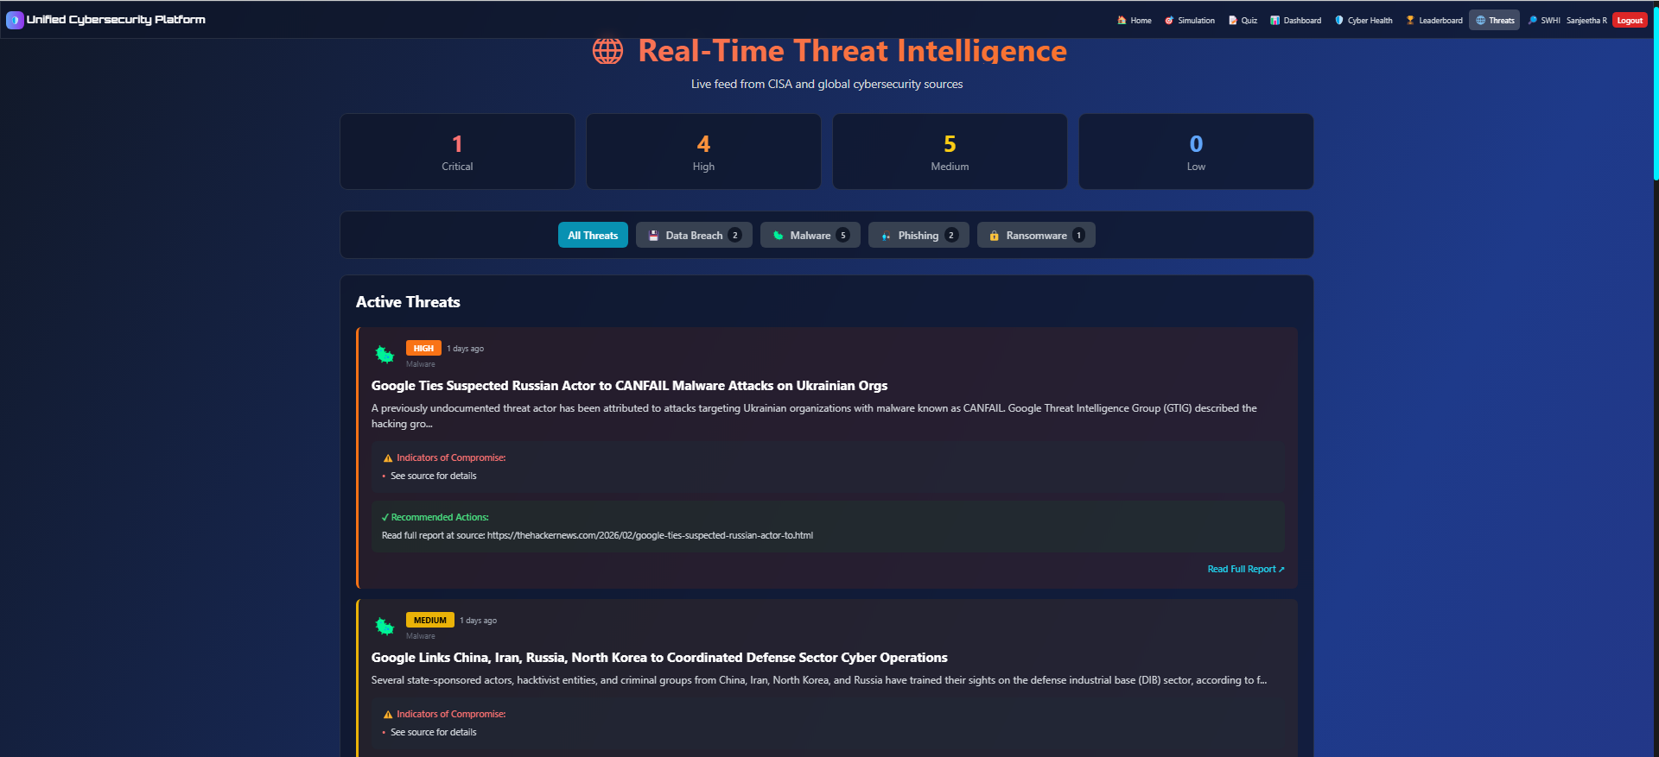
Screenshots

Slide 16
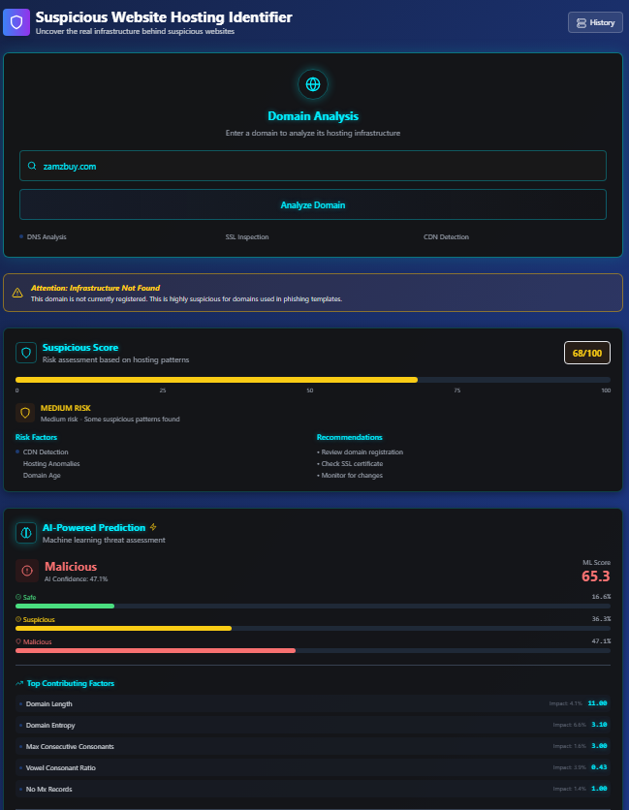
Screenshots

Slide 17
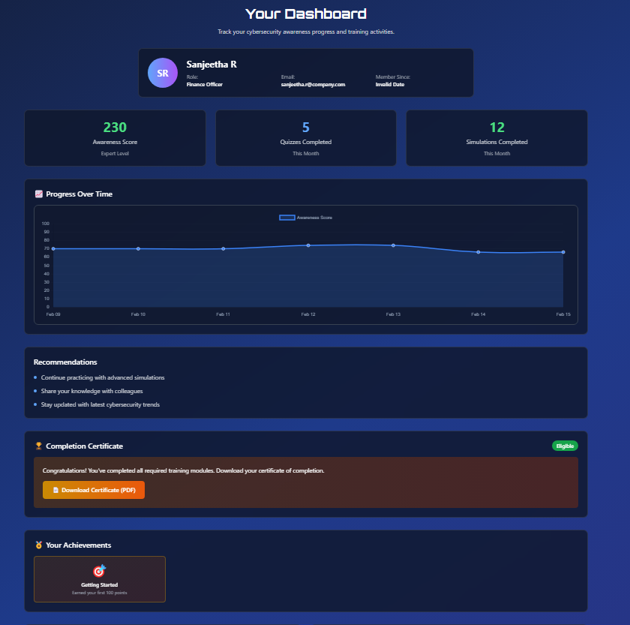
Screenshots

Slide 18
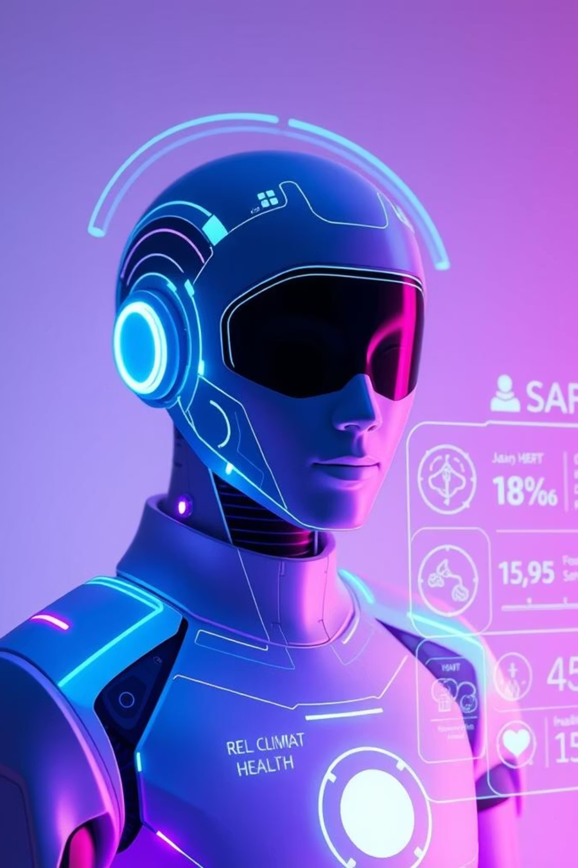
Role of Agentic AI and Gen AI in the solution
Agentic AI (Orchestration Layer)
Observes user actions across simulations, quizzes, and email analysis
Coordinates analysis flow and scoring updates
Enables behavior-driven personalization
Generative AI (Explain & Educate Layer)
Provides clear, human-readable explanations of phishing indicators
Delivers AI-assisted voice feedback for user actions
Uses controlled, explainable AI with rule-based safeguards
Ensures transparency and enterprise suitability

Slide 19
Novelty and Uniqueness
1
2
3
4
Real-World Threat Exposure
SWHI – Infrastructure-Level Threat Discovery
Explainable AI with Measurable Cyber Health
Behavior-Driven Security Awareness

Slide 20
Git Hub Link
https://github.com/Archanasr13/VOIS-Marathon-Project

Slide 21
Future Scope
Addition of advanced phishing scenarios and attack variations
Cloud-based scalability to support more users and organizations
Integration of advanced AI models for improved behavior analysis
Expansion of threat intelligence sources and automated reporting

Slide 22
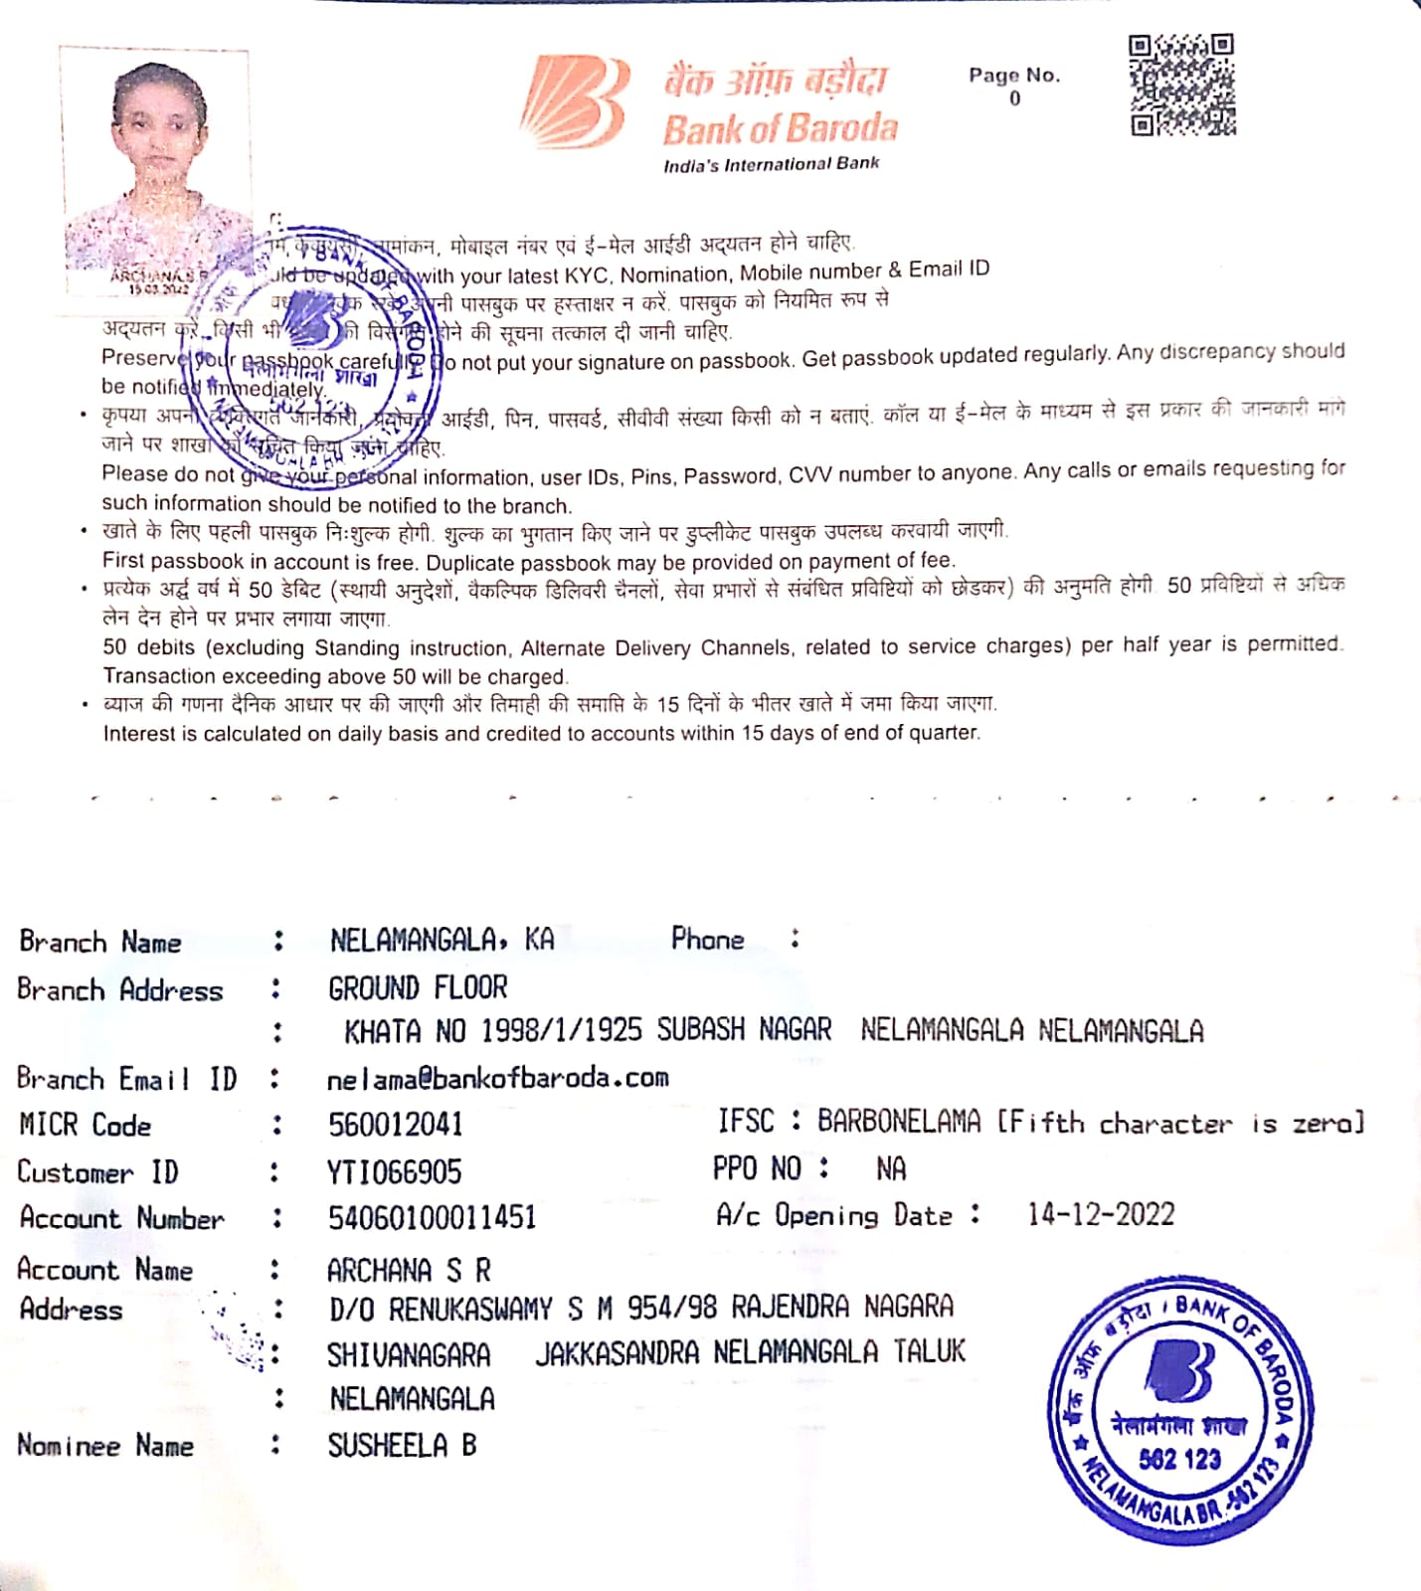
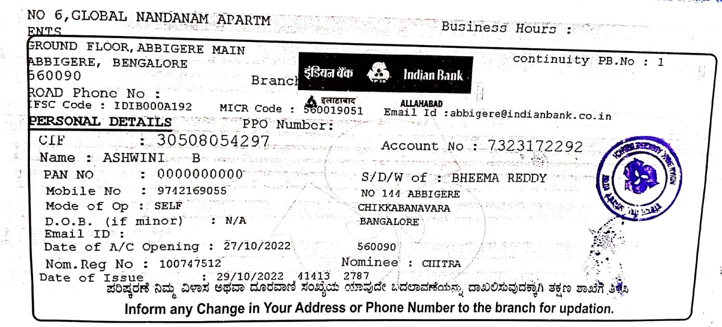
Bank Details
Full Name (as per bank records): | Bank Name | Branch Name | Account Number | Account Type (Savings / Current) | IFSC Code
Archana S R | Bank of Baroda | NELAMANGALA | 54060100011451 | Savings account | BARB0NELAMA
Ashwini B | Indian bank | ABBIGERE | 7323172292 | Savings account | IDIB000A192
Team Member 1 Passbook/ Bank Statement With Name and Account Number
Team Member 2 Passbook/ Bank Statement With Name and Account Number

Slide 23
Thank You

